Slide 2
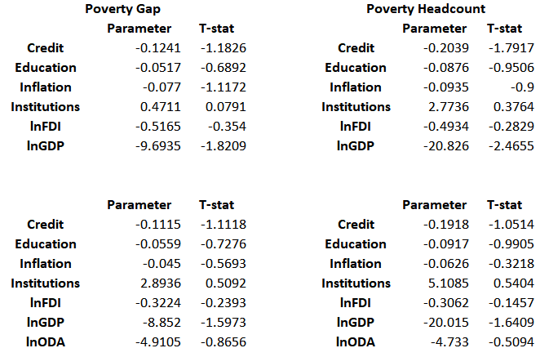
Results

Slide 3

Stylized examples

